Slide 1
ZAHARA
Transforming finance teams

Slide 2
Spend Approvals
Purchase Orders
Invoice automation
Budgets
Reporting
Expenses
Approve
Reject

Slide 3
Low volume – Keep it simple
Medium volumes – Sophisticated functionality
Very high volumes– Sophisticated functionality
STP
Small SME /
Micro / Book-Keepers
Accountants
Larger SME
Big Accountants
Enterprise
Ent Depts
Rapid Growth

Slide 4
OUR TIMELINE
2007 Click2Scan Ltd
Started – Scanning
& Document Management
2009 ABBYY partner for
Intelligent OCR software
2012 ABBYY Release
Invoice recognition software
2016 First release of Zahara used by Signature SL
2015 Zahara designed and development started
2013 Started Sage development for integrations
2017 Built-in
approvals
2018 Integrations and move to Azure
2019 Mobile
app
2020 Built-in
invoice OCR
2021 Staff Expenses, AutoPilot

Slide 5
ABOUT US
Sales, Support & Admin
Based in Bath, UK
Sales & Support
Brisbane, Australia
Sales & Support
North America
Development
Based in Krakow, Poland
Development
Hyderabad, India

Slide 6
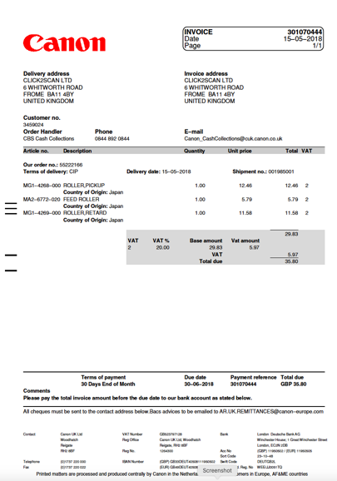
CURRENT SITUATION
Who ordered this?
Has it been delivered?
How do we code it?
Who’s budget is it?
Should we pay it?

Slide 7
INTEGRATIONS

Slide 8
HOW IT WORKS
Request to
buy something
Receipt
Delivery
Invoice
approval
Approval
process
Receive & Read
Invoice
Dispute process
& credit note
Send purchase
order to supplier
Match
order / invoice
Post to
accounts

Slide 9
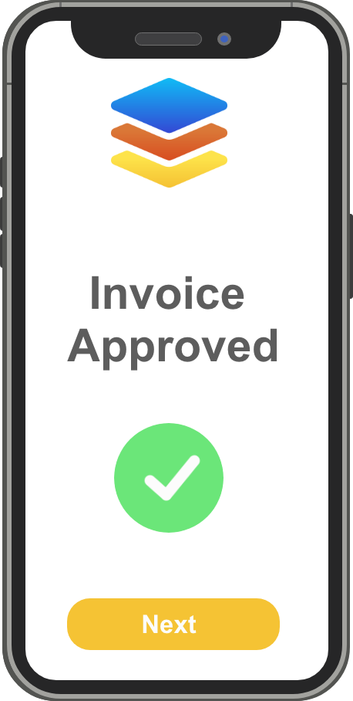
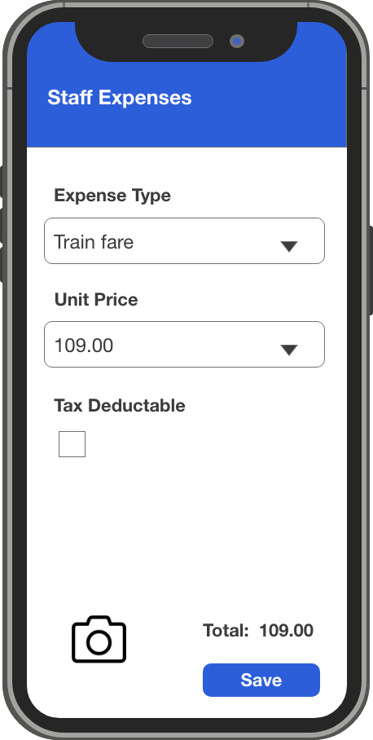
MOBILE APP
Approvals
Raise Orders
GRN Orders
Expense Claims
Submit Invoices

Slide 10
ON PREMISE TOOL

